Slide 1
Sentimental Analysis on Twitter Database
Revanth Segu
Vikram Suriyanarayanan
Shruthi Deshpande
Sonal Hundekari

Slide 2
Table of Contents
Overview
Algorithm overview
Implementation Details
Test and Results
Future Work

Slide 3
Overview
Determine the attitude of a speaker with respect to some topic.
Classify the polarity of a given text at the document/sentence/feature level to positive, negative, or neutral attitude.

Slide 4
Algorithm Overview
Data Collection
Retrieve relevant tweet information from JSON object
Map Reduce Job to retrieve individual candiadtes Tweets
Predict result based on Sentiment counts of tweets using MapReduce
Train classifier with sentiment corpus on Mahout
Test unlabeled tweets against trained classifier

Slide 5
Data Collection
Twitter Database containing JSON objects about 2012 elections
Sample Format of JSON object in tweets:
{"retweet_count":0,”":[], "text":"Whoo hoo for 2012“, contributors":null, “Sun Jan 01 07:01:00 +0000 2012"id":153370119647670273, "truncated":false}

Slide 6
Preprocessing Data
Retrieve relevant tweet information from JSON object
Mapper class to extract "text" and "id" fields of the tweets.
Extracted .tsv file format:
153748110324142081 You'll give it up

Slide 7
Map Reduce Job
Extracting messages from tweets
Check the tweets containing words "Obama" or "Romney".
Search for related keywords such as
"Obama", "romney", "democrat", "republican", "mitt", "barrack", "michelle", "#Obama", "#RomneyRyan", "Mitt".

Slide 8
Classification
Convert tsv file into a sequential file
Training the classifier with sentiment corpus on Mahout
Testing tweets against the trained classifier
Checking counts of sentiments using MapReduce

Slide 9
Test Result
Obama Count:
Negative 0 5085k
Neutral 2 5117k
Positive 4 3631k
Romney Count:
Negative 0 1300k
Neutral 2 800k
Positive 4 585k

Slide 10
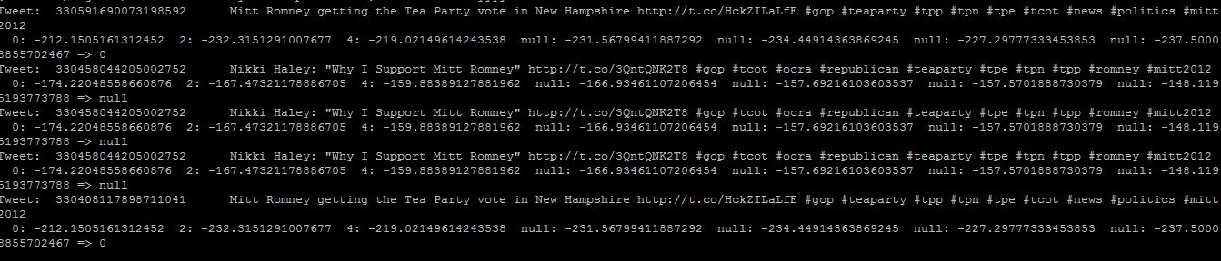
Test Result

Slide 11
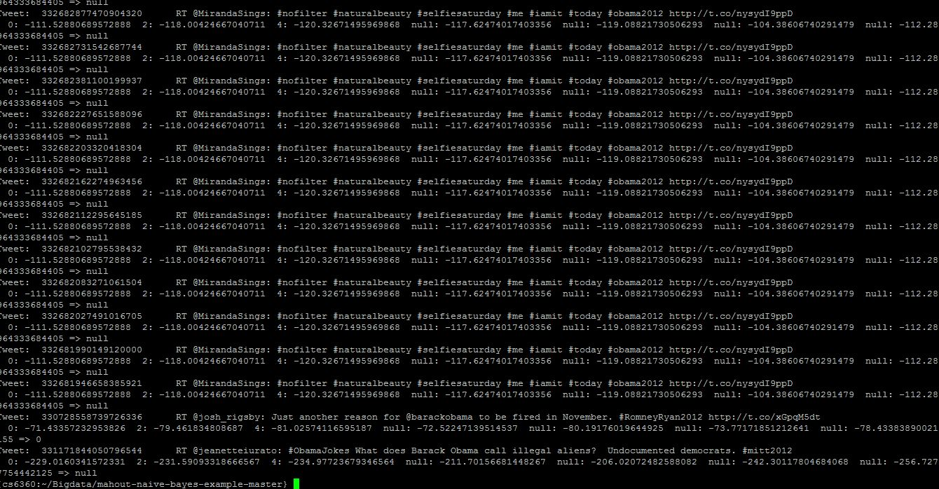
Test Result

Slide 12
Future Work
Bigrams, Trigrams, POS tagger
Other features such as Emotion Icons, Exclamation Marks, Negation words, Intensity words.
Predicting elections in independent states.

Slide 13
Thank you

